Slide 1


Implementation of Campus area network system(CAN)
Computer Network [CSE 3204]
PRESENTED TO
Dr. Fernaz Narin Nur Associate Professor Department of CSE Notre Dame University Bangladesh
PRESENTED BY
Name : Abrity Paul Chowdhury
Batch : CSE 17
ID : 0692130005101005
01

Slide 2



Contents
Introduction
Key components of a CAN system
Procedure Steps
Benefits
Conclusions
02

Slide 3

INTRODUCTION
03

Slide 4


A Campus Area Network (CAN) is a localized network that interconnects computers, servers, and other digital devices within a specific geographical area, typically a college or university campus. It enables seamless communication, data sharing, and resource access among the various academic, administrative, and research facilities within the campus.
04

Slide 5
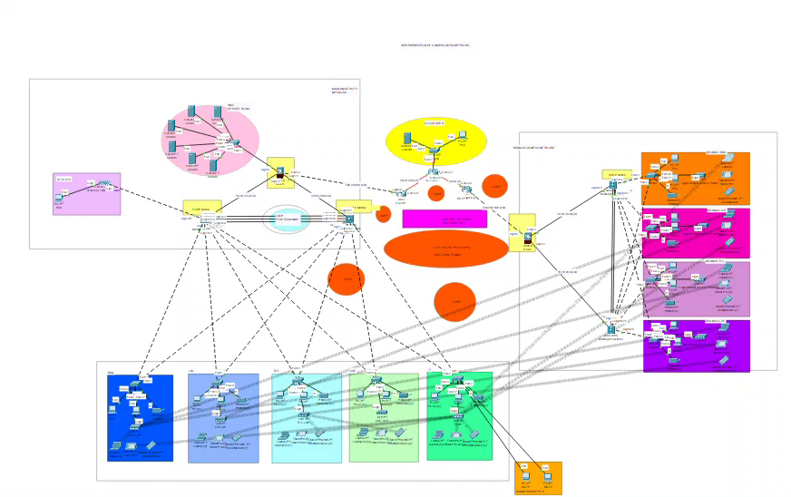
FIGURE 1 : CONFIGURING CAMPUS NETWORK SYSTEM
05

Slide 6


KEY COMPONENTS OF CAN SYSTEM
Ethernet Switches
Wireless Access
Ethernet switches interconnect various devices and network segments, enabling efficient data communication across the campus area network.
Strategically placed wireless access points provide seamless wireless connectivity for mobile devices and enable untethered access to network
Network Servers
Routers & Firewalls
Powerful network servers host critical applications, manage user accounts, and provide centralized storage and computing resources for the campus community.
Routers and firewalls regulate network traffic, enforce security policies, and ensure secure connectivity between the CAN and external networks.
06

Slide 7
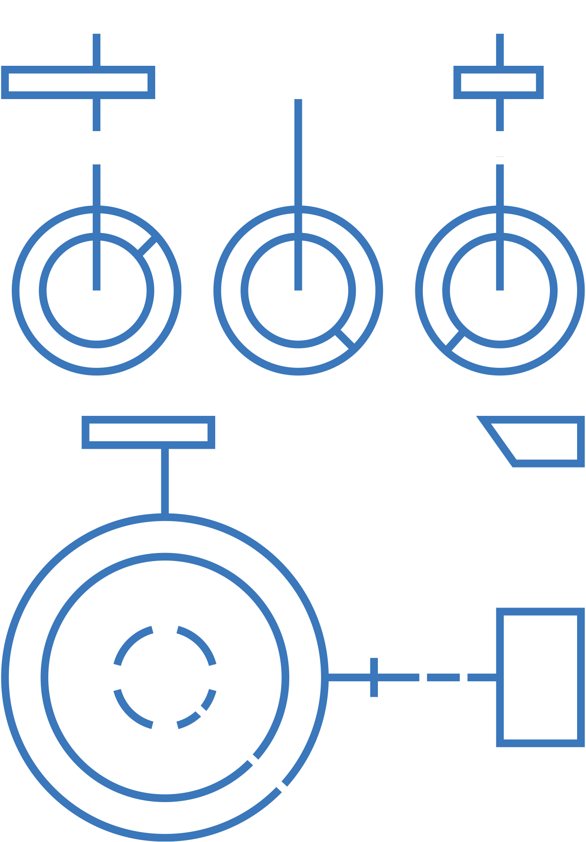
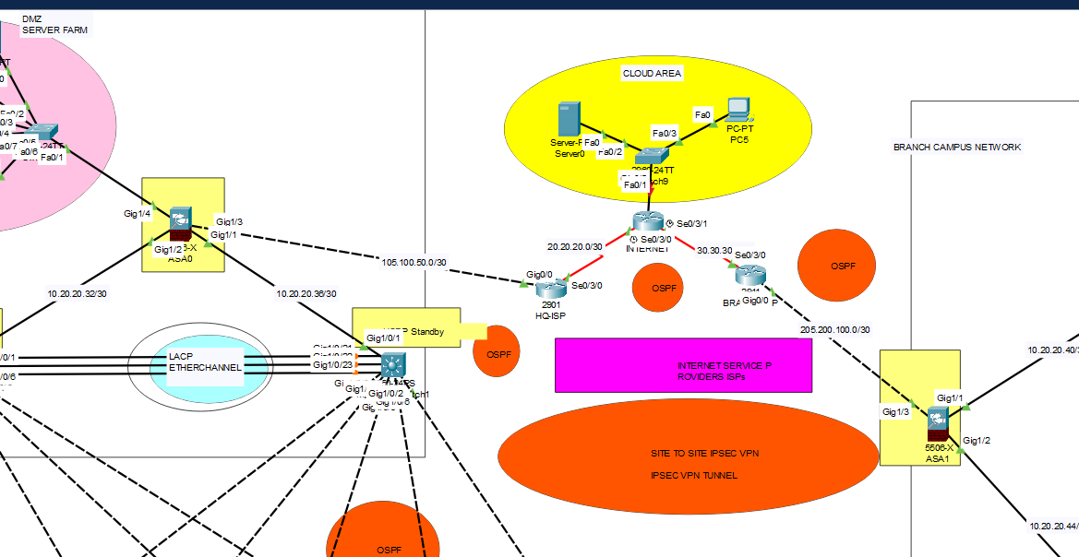
PROCEDURE STEPS
Hierarchical Design: Implementing a hierarchical network model with redundancy to enhance resilience.
ISPs: Establishing connectivity to an ISP Router within the network infrastructure.
WLAN: Equipping each department with a Wireless Access Point (WAP) to provide Wi-Fi access for employees, corporate users, external auditors, and guests, all centrally managed by a Wireless LAN Controller (WLC).
VLAN: Maintaining VLANs with IDs: 10 for Management, 20 for LAN, 50 for WLAN, and 199 for Blackhole, where all unused ports are placed.
EtherChannel: Using the Link Aggregation Control Protocol (LACP) for EtherChannel configuration to improve link aggregation efficiency.
STP PortFast and BPDUguard: Configuring Spanning Tree Protocol (STP) PortFast and BPDUguard to speed up port transitions from blocking to forwarding states.
FIGURE 2 : CONFIGURING ISPS
07

Slide 8

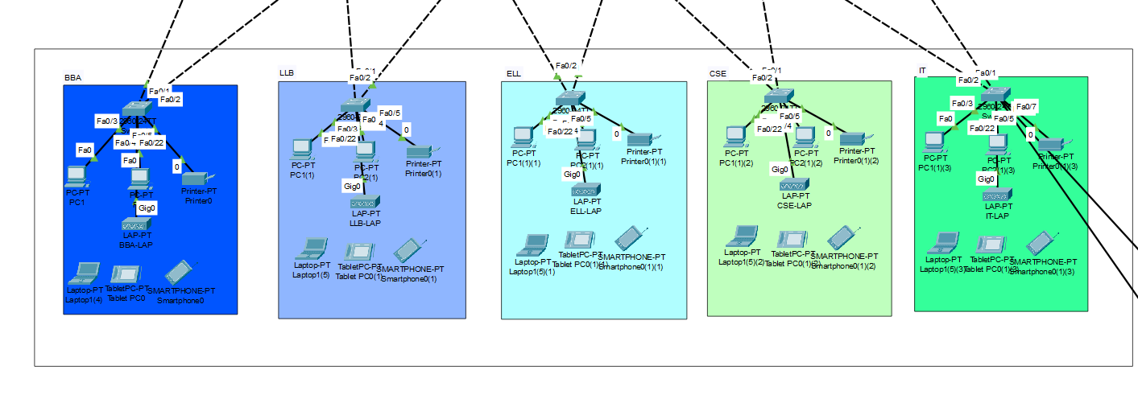
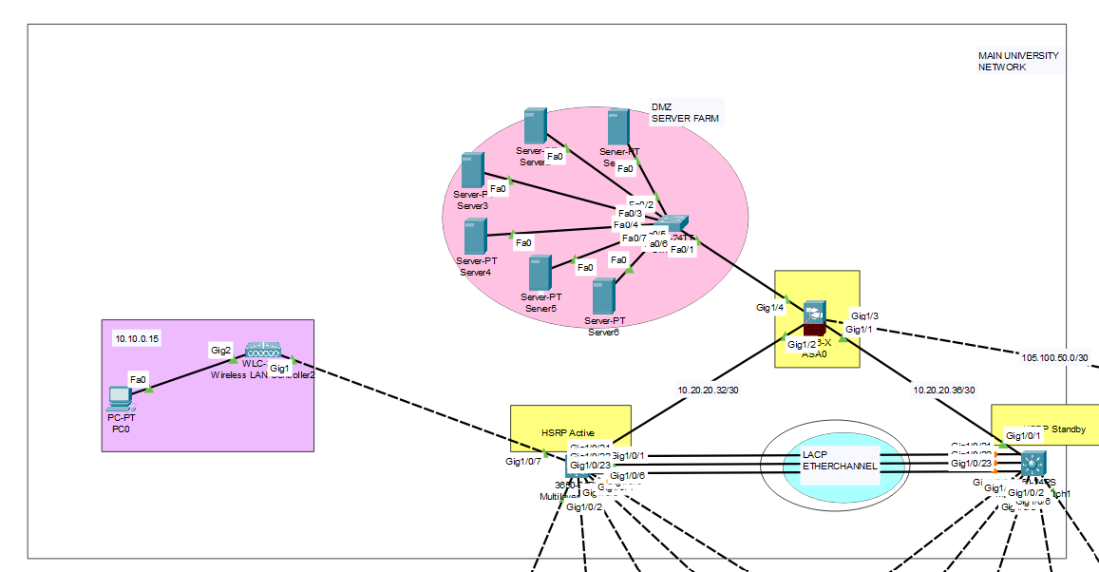
PROCEDURE STEPS
Subnetting: Applying subnetting techniques to allocate the appropriate number of IP addresses to each network group.
Basic Settings: Configuring fundamental device settings, including hostnames, console passwords, enable passwords, banner messages, password encryption, and disable IP domain lookup.
Inter-VLAN Routing: Enabling communication between devices in all departments by configuring inter-VLAN routing on the multilayer switch.
Core Switch: Assigning IP addresses to multilayer switches to enable both routing and switching functionalities.
DHCP Server: Ensuring that all devices in the network obtain IP addresses dynamically from the DHCP servers located at the server farm site.
FIGURE 3: CONFIGURING END DEVICES
FIGURE 4: CONFIGURING SERVERS &WLC
08

Slide 9

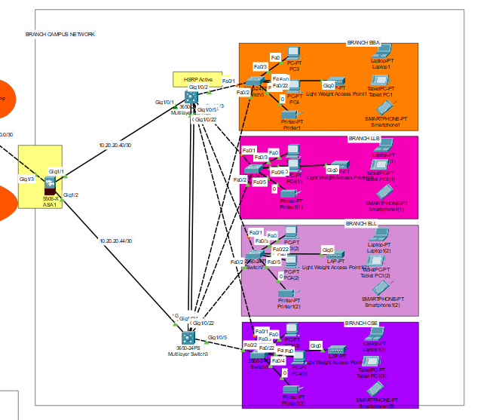
PROCEDURE STEPS
HSRP: Implementing the Hot Standby Router Protocol (HSRP) to achieve redundancy, load balancing, and failover capabilities.
Static Addressing: Allocate static IP addresses for specific devices.
Routing Protocol (OSPF): Use Open Shortest Path First (OSPF) as the routing protocol.
Standard ACL for SSH: Establish a simple standard access control list on the VTY line to permit remote administrative tasks via SSH only for the senior network security engineer's PC.
Cisco ASA Firewall: Configure default static routes, basic settings, security levels, zones, and policies on the Cisco ASA firewall to define access control and resource utilization within the network.
FIGURE 5: CONFIGURING BRANCH USING ASA FIREWALL
09

Slide 10


BENEFITS
Enhanced Reliability and Redundancy: Hierarchical design and redundancy measures, such as HSRP and EtherChannel with LACP, ensure high availability and minimize downtime.
Centralized Management: The use of a Wireless LAN Controller (WLC) allows for efficient, centralized management of wireless access points, simplifying network administration and improving user experience.
Improved Security: VLAN segmentation, along with Cisco ASA firewall policies and ACLs for SSH, provide robust security, protecting the network from unauthorized access and threats.
Scalability: The system is designed to be scalable, accommodating future growth and the addition of new devices without compromising performance.
Optimized Performance: Technologies like STP PortFast, BPDUguard, and efficient IP management through subnetting and DHCP ensure optimal network performance and swift transitions, reducing latency and enhancing user productivity.
Inter-VLAN Communication: Inter-VLAN routing facilitates seamless communication between different departments, promoting collaboration and operational efficiency.
Dynamic IP Management: DHCP servers automate IP address allocation, simplifying network configuration and management, and reducing administrative overhead.
10

Slide 11

In conclusion, the Cisco-based Campus Area Network (CAN) delivers a robust, scalable, and secure infrastructure. It ensures high availability and performance through hierarchical design, redundancy, and efficient management of wireless access and VLANs. The network's security is fortified with comprehensive measures, while dynamic IP management simplifies administration. Overall, the system effectively supports the needs of a modern campus environment.
11

Slide 12

THANK YOU
12

